Slide 1
How to Enhance Your Data with Open Data
Dean Allemang & Bryon Jacob

Slide 2
Who are we?
Dean Allemang
Bryon Jacob
Principal, Working Ontologist LLC
Author, Semantic Web for the Working Ontologist
https://data.world/dallemang
@WorkingOntology
CTO & Co-founder, data.world
https://data.world/bryon
@bryonjacob

Slide 3
What are we going to cover?
Overview of our example case study
Managing data in data.world
The benefits of a semantically-aware data collaboration platform
Linking to open data sources for enhancing your own data sets
Using standard open classifications to categorize your data for analysis

Slide 4
Setup
To work along with this tutorial you need a couple of dependencies:
A https://data.world account
R and RStudio
The ggplot2 library installed
Having Excel would be handy, but not required
Detailed instructions for setting these things up are at:
https://bryonjacob.github.io/SmartData2017/

Slide 5
Technology covered
We’re going to work with several technologies in this tutorial:
RDF/RDFS and SPARQL (don’t worry, we will cover these at a beginner level for folks who have no familiarity)
We’re going to do our analysis in R, but the techniques are applicable in whatever analytical platform you are most comfortable with

Slide 6
Standards
UNSPSC
NAICS
United Nations Standard Products and Services Code
North American Industry Classification System

Slide 7
Notes:
So, many of you might be familiar with the game “The Settlers of Catan” – it’s a resource management game, set in the fictional world of Catan, where players cultivate resources like wood, bricks, sheep, and grains, and leverage them to build settlements and cities in an effort to colonize the i

Slide 8
AML/KYC
Notes:
To make the game even more fun - we’re going to institute an AML/KYC policy on Catan, and force the dock administration to audit the commerce taking place through the port, looking for irregularities that might indicate malfeasance.

Slide 9
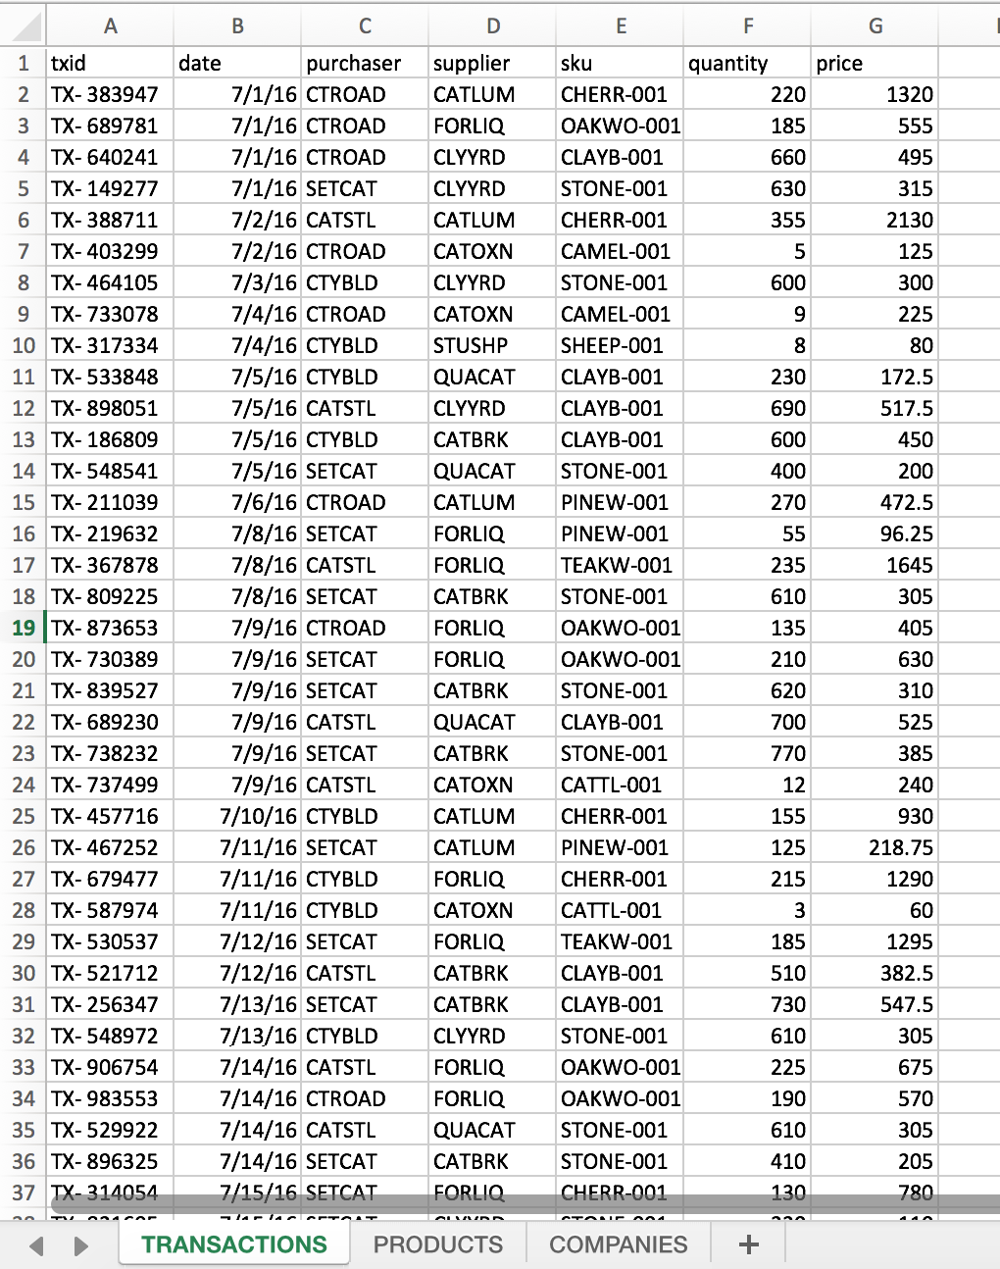
We will start from a spreadsheet containing the transactions that went through the dock during the second half of 2016.
Each record includes
A unique transaction ID
The date of the transaction
Codes for the purchaser and the supplier
The SKU for the product purchased
The quantity purchased
And the total price of the transaction

Slide 10
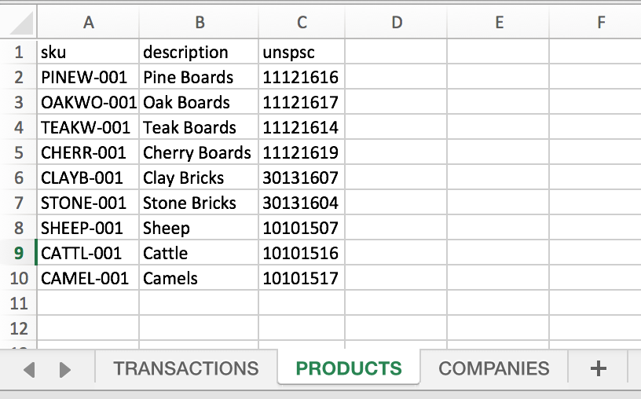
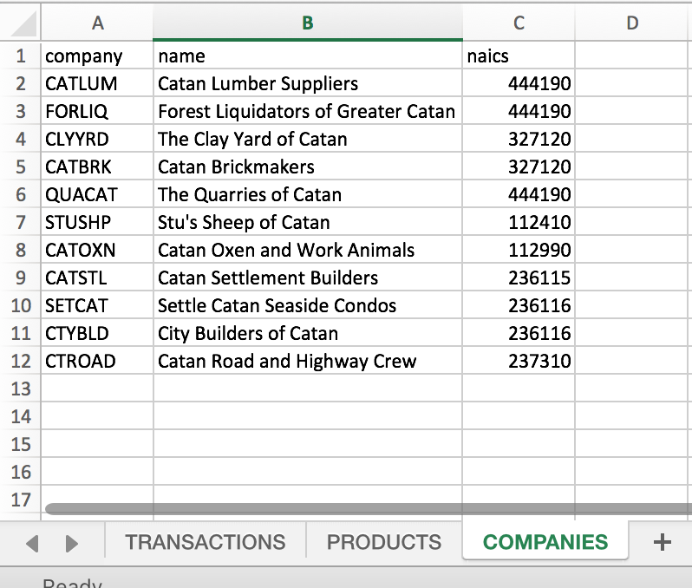
There are also two lookup tables
PRODUCTS maps the product SKUs to a description of the product and to an UNSPSC code
COMPANIES maps each company ID to a description and to a NAICS code

Slide 11
Import the Excel file into data.world
Data preview card - highlights
Switch to column overview, highlight column metadata and stats
Click “see all” on transactions to show a full-screen preview
Query the data…

Slide 12
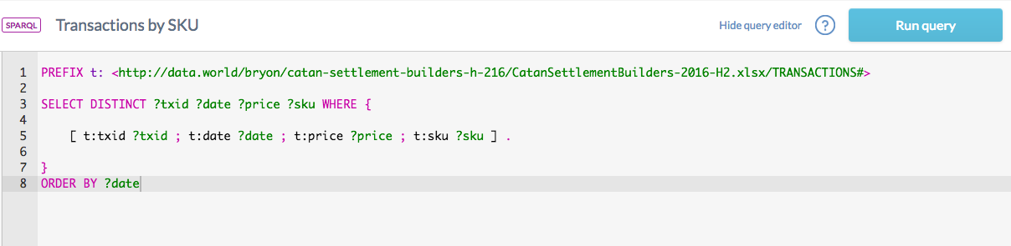

Slide 13
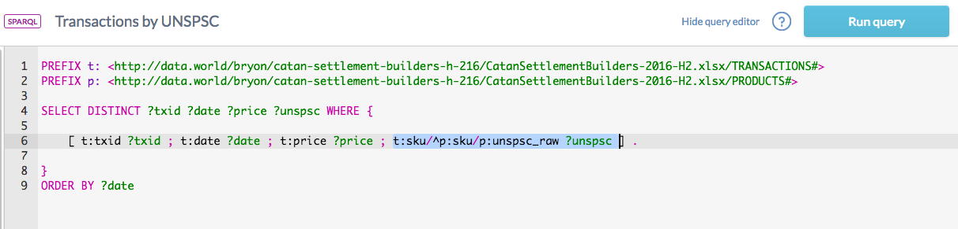

Slide 14
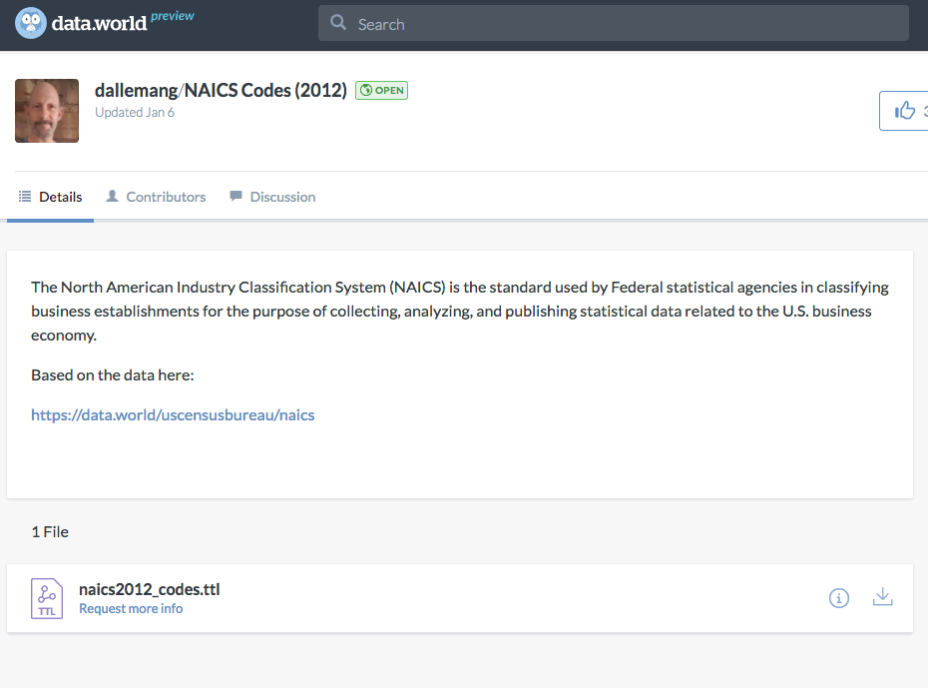
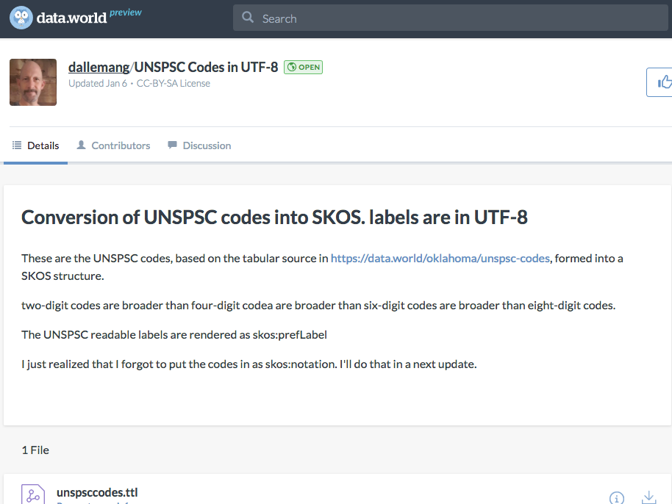
Dean has been kind enough to create two semantically linked datasets – one for the UNSPSC codes and one for the NAICS codes. These datasets contain the hierarchical linkages between the various levels of the code structure.
We can get some automated CATEGORIZATION and DIMENSIONREDUCTION when we JOIN our dataset to those, to leverage that structure...

Slide 15
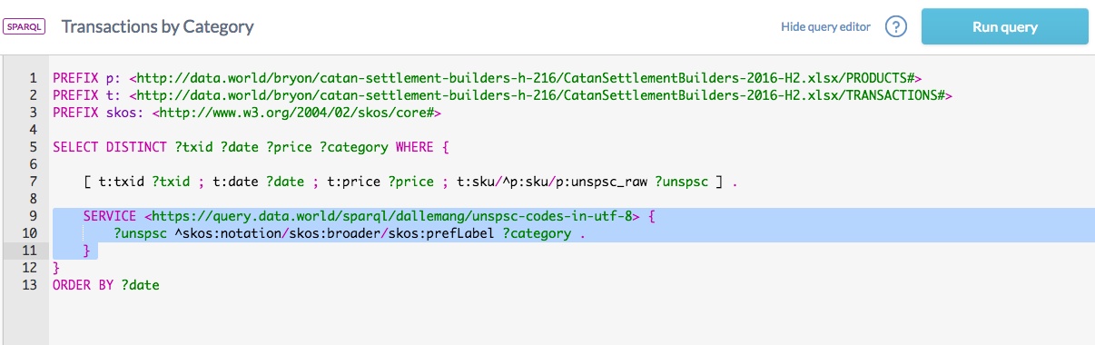

Slide 16
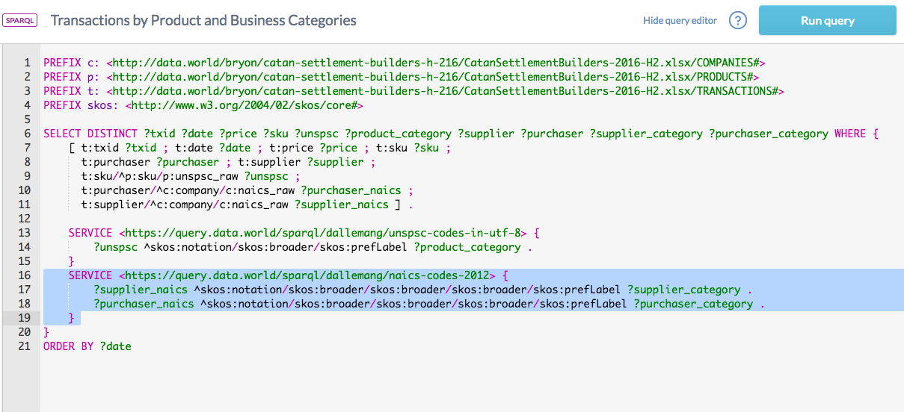

Slide 17
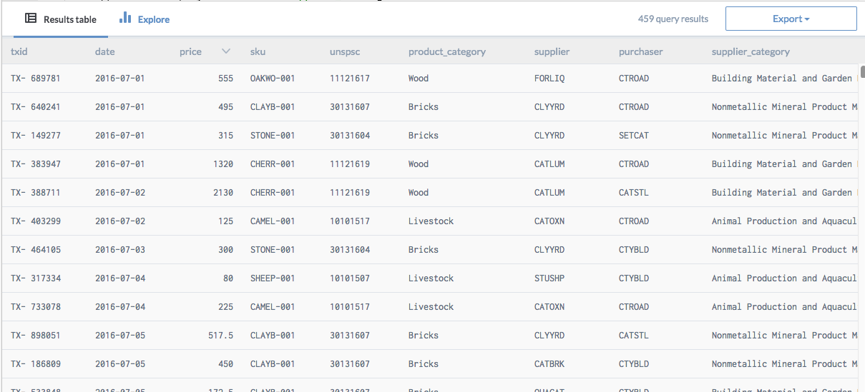

Slide 18
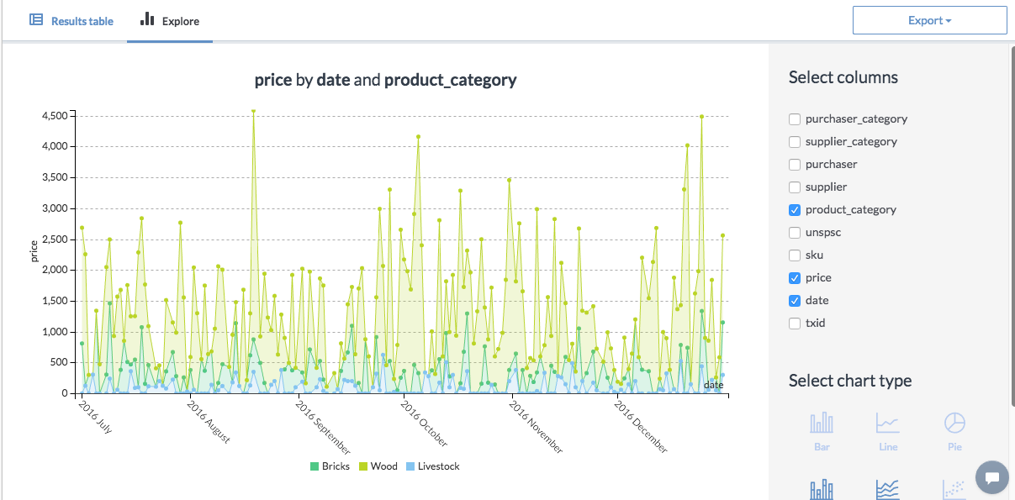

Slide 19
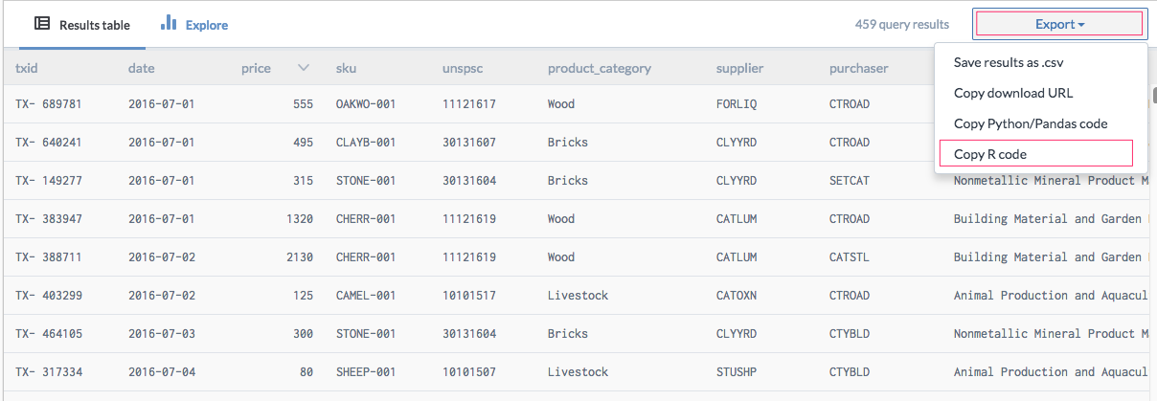

Slide 20
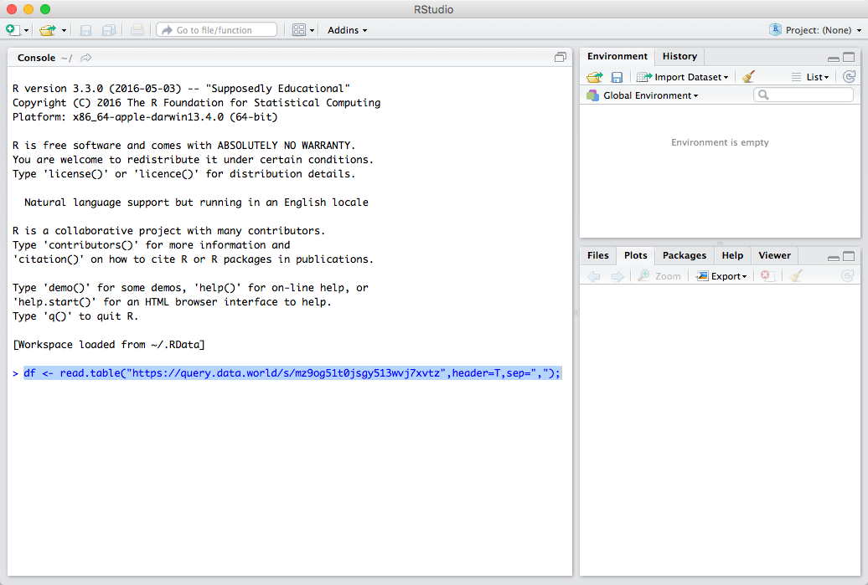

Slide 21
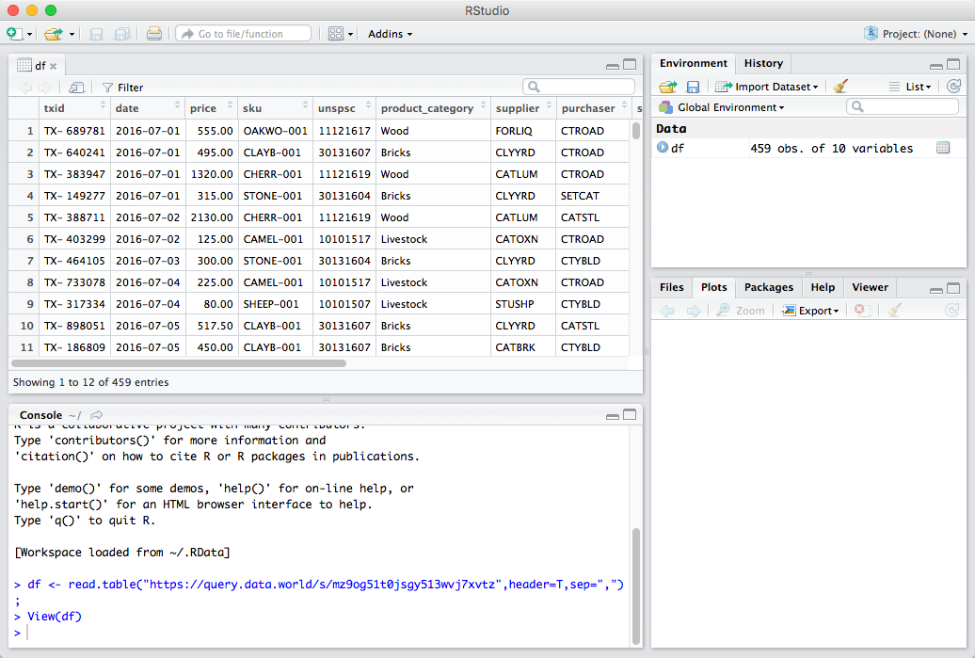

Slide 22
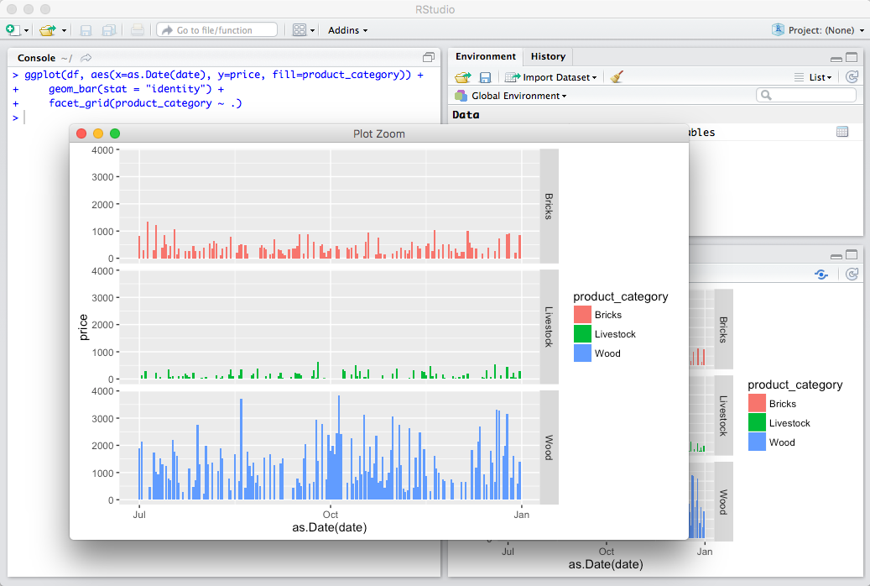

Slide 23
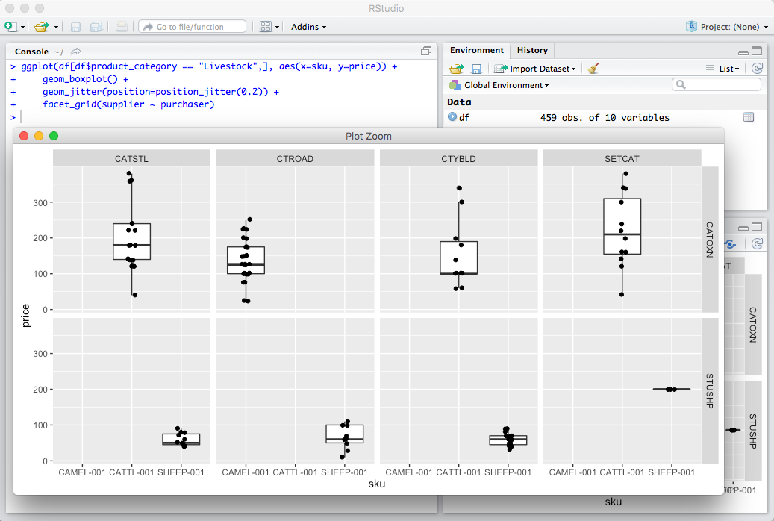

Slide 24
Wrapping up
Upload R code for analysis and interesting images back into data.world
Publish SPARQL Queries alongside data to preserve linkages to UNSPSC and NAICS codes
Add notes in commentary to mention the linking and categorization

